Slide 1
Enhancing copies in the Core of Relational Databases
March 11th, 2022

Slide 2
01 – Previous meeting wrap up
02 – Task completion
03 – Current status
04 – Next steps

Slide 3
01
Previous meeting wrap up

Slide 4
Previous meeting comments
ESADE introduced Nahuel Statuto
ESADE presented the initial implementations of the dual pass.
ESADE evaluated three alternatives on spiral dataset with limited memory 100 points in 2 dimensions.
The experimental evaluation maps SVM to a DNN
The solution requires a few metadata about attribute domain range
A restriction of the current best solution is that it requires a method with a learning rate parameter (online capabilities?). Many ML methods such based on gradient descent (logistic regression, linear regression, xgboost, DNN) fulfil this requirement
ESADE will think about how to decide the initial number of points. It might be possible to derive some mathematical formula depending on the data complexity and distribution.
Next steps scale with more dimensional data, and more complex problems

Slide 5
03
Current status

Slide 6
Current Status
01
Develop the mathematical foundation of the problem
02
New insights derived from the mathematical theory

Slide 7
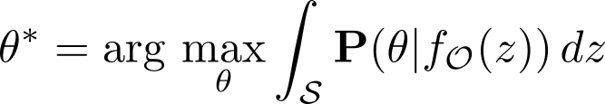
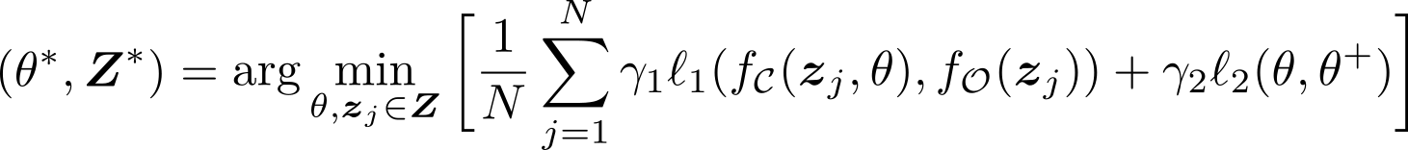
The Copying problem
Copying requires gaining knowledge about a model’s decision behaviour throughout the space. In absence of the original data, we need to generate synthetic samples $z$ to access this information
In the simplest approach we can discretize this term by running a single iteration
where

Slide 8
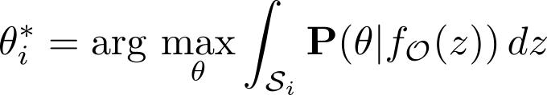


New mathematical framework
Best fit parameter will be estimated step by step as synthetic data is shown to the copy:
At each step data is weighted. Memory arise from mathematical model itself and low-weight data can be deleted to get a fix memory size.

Slide 9
Current Status
01
Develop the mathematical foundation of the problem
02
New insights derived from the mathematical theory

Slide 10
Improving the implementation
The mathematical model give us insight of how to weight each data point
Different weights:
Geometrical weight (based on distances between classes)
Error weight (memory; based on the accuracy respect the Oracle)

Slide 11
04
Next Steps

Slide 12
Next Steps
01
We will continue developing the mathematical theory
02
New insights will used to improve the basic existing algorithm

Slide 14
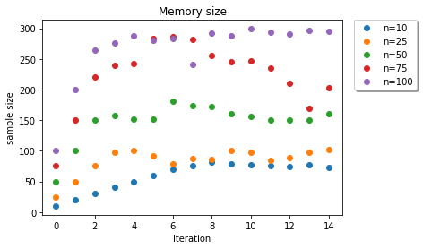
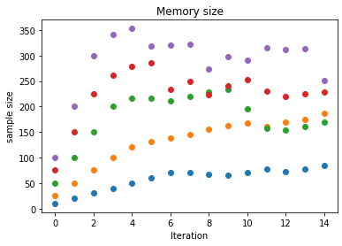

First results for $ρ$
geometrical
Errors

